Slide 1
CSS and CSS3

Slide 2
Topics
The Power of CSS
The History of CSS
Introducing CSS3
Box Model
Browser Support
Selectors and Pseudo Classes
Fonts and Text Effects
Fonts on the Web

Slide 3
CSS-Version 1
Published in December 17, 1996.
Had support for
  Font properties like typeface and emphasis
  Color of text, backgrounds, and other elements
  Text attributes such as spacing between words, letters, and lines of text
  Alignment of text, images, tables and other elements
  Margin, border, padding, and positioning for most elements

Slide 4
CSS –Version 2
CSS Version 2 published in May 1998.
  absolute, relative, and fixed positioning of elements
  z-index, the concept of media types,
  support for aural style sheets
  Bidirectional text
  Font properties such as shadows.

Slide 5
CSS-Version 3
CSS 3 is divided into several separate documents called "modules".
Each module adds new capabilities or extends features
As of June 2012, there are over fifty CSS modules
Some of the Modules are :
  Media Queries
  New Selectors
  Color
  Backgrounds and Borders
  Multi-column Layout

Slide 6
Style Source
User Agent
  The browser’s default style sheet.
  Has the lowest priority.
Author
  CSS provided by the page - inline, embedded or external
User
  The end-user viewing a website.
  Can override the author's styles
  Done for accessibility reasons.
Cascading Rule-Specificity
If two equally specific rules can apply to the same element
  The one that comes last in the style sheet is used.

Slide 7
CSS UNITS - Sizes
Relative length measurements:
  px (pixels – size varies depending on screen resolution)
  em (usually the height of a font’s uppercase)
  ex (usually the height of a font’s lowercase)
  Percentages (of the font’s default size)
Absolute-length measurements (units that do not vary in size):
  in (inches)
  cm (centimeters)
  mm (millimeters)
  pt (points; 1 pt = 1/72 in)
  pc (picas; 1 pc = 12 pt)

Slide 8
COMMENTS IN CSS
CSS uses the "block comment“
  comment with Start with /*, and end it with */.
  <style>
  /* p {
  font-family: sans-serif;
  font-size: 15pt;
  } */
  </style>

Slide 9
Style Classes
Added to the elements of a that type should use a style rule.
  In CSS selectors defines the class name, which is preceded by a period.
  In HTML, the Element has the class attribute to specify class name
Class name should be descriptive of the purpose and not Presentation
  nav, news, footer
  redText,smallText,GreenBorder

Slide 10
Style Classes
Style classes be “generic,”
  not tied to a specific element type.
  .mytag {
    font-size: 23px;
    background: gray;
  }
Style classes can also be tied to specific Element
  a.anchorStyle { text-decoration : none }
  <a class="anchorStyle" href="somepage.html">Link text</a>

Slide 11
Example
  .general-div {
  width: 300px; height: 300px; border: 1px solid #000;
  }
  .general-div.special {
  background-color: red;
  }
<div class="general-div">Basic Division</div>
  <div class="general-div special">
  Division with Background Color
  </div>

Slide 12
BOX MODEL

Slide 13
Box Model
Introduction - Inline vs. Block level
  Margin
  Borders
  Padding
  Outlining
  Visibility & Display
  http://www.css3-tutorial.net/css-box-model/introduction-inline-vs-block-level/

Slide 14
Box Model
HTML element can be in one of the following states:
  Block,
  Inline
Can Change an inline element to a block element, or vice versa,
  li { display: inline; }
  span { display: block; }

Slide 15
Block-Level and Inline Elements
Block level element
  Creates a “block” or “box”.
  Element will span the entire available width
  Displayed with a new line.
  It may contain inline elements and other block-level elements.
Inline Element
  Does not break the current flow.
  Takes up the Just the space it needs to render its content
  Elements do not begin with new line.
  Can contain only data and other inline elements.
  The width and height properties are ignored for inline elements.

Slide 16
HTML Elements
Block-Level Elements
Inline Elements
<article>
<aside>
<div>
<form>
<h1> to <h6>
<hr>
<table>
<li>
<a>
<img>
<span>
<button>
<input>
<label>
<select>
<textarea>

Slide 17
Inline and Block Elements
  <div>
  <span>Hello</span>
  <span>World</span>
  </div>
  <div>
  <div>Thank</div>
  <div>You</div>
  </div>
Hello
Thank

Slide 18
Box Model
Block elements are inside a box
  They have margins, padding and borders
Element’s layout is composed of the following:
  Element’s content area.
  border around the element.
  padding between the content and the border (inside the border)
  margin between the border and other content (outside the border)
Width = width + padding-left + padding-right + border-left + border-right
Height =height + padding-top + padding-bottom + border-top + border-bottom

Slide 19
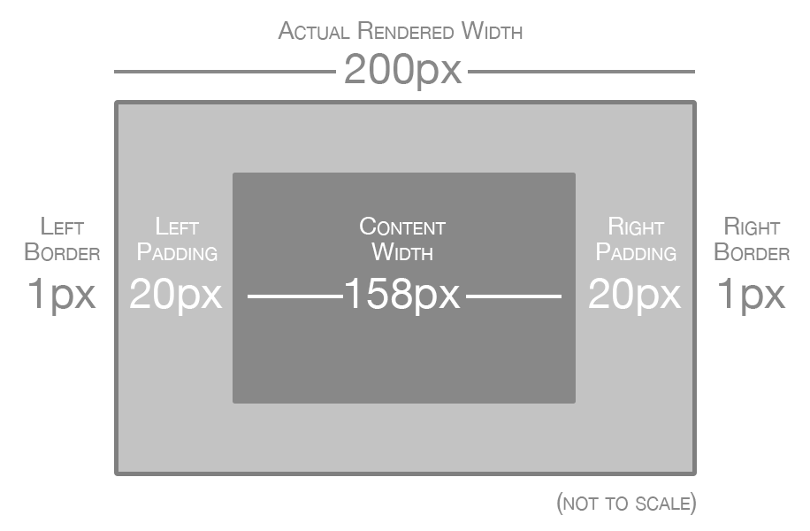
Demo
  http://codepen.io/vatsank/pen/rjJLqm

Slide 20
Outlining
A kind of an extra border, for visual attention to element.
The shorthand property includes
  outline-width, outline-style and outline-color
.box {
background-color: #eee;
outline: 3px solid LightCoral;
border: 3px solid LightBlue;
padding: 5px 10px;
}
Differences between border and outline
  Cannot apply a different outline width, style and color for the four sides of an element
  Its is not a part of the element's dimensions
  The browser won't reserve the required space outline

Slide 21
Visibility & Display
Both of them are used to control visibility:
The visibility property
  The initial value of the visibility property is visible,
  Element is visible unless its changed
<div class="box" style="visibility: hidden;">Box 2</div>
The element can't be seen, but the browser still reserves the space for it

Slide 22
display
To specify the type of rendering box used for an element.
display:none
  Turns off the display of an element
  All descendant elements also have their display turned off.
  The document is rendered as though the element doesn't exist in the document tree.
Hidden an element and be shown again by setting display to either inline or block
The element can't be seen, and the browser does’t reserves the space for it
<div class="box" style="display: none;">Box 2</div>

Slide 23
CSS PROPERTIES

Slide 24
Categories of CSS properties
Margin and Padding
Border
Font and text related
Color
Positioning and layout handling related.
Background related properties.
Lists related.
Table related.

Slide 25
Margins
Define the space around elements outside the border
It can have negative values to deliberately overlap content
  Can use translate() instead
May affect the position of background elements (graphics and/or colors) in relation to the edges of the containing block element
Can be defined independently on top, right, bottom and left
Can also use CSS shorthand

Slide 26
CSS Margins
  margin-bottom : specify the bottom margin of an element.
  margin-top : specify the top margin of an element.
  margin-left : specify the left margin of an element.
  margin-right : specify the right margin of an element.
  margin shorthand property for setting margin properties in one declaration.
<div style=“margin: 20px;”> Margin from all sides.</div>
Possible values: auto, length in px, %.

Slide 27
Margin
<div style=“margin-top: 10px;”>
<div style=“margin-bottom: 10px;”>
<div style=“margin-left: 10%;”>
<div style=“margin-right: 10%;”>
[top] [right] [bottom] [left]
<div style=“margin :10px 20px 30px 40px”>
p {margin: 15px; } : all four margins will be 15px
padding: 2px 1em 0 1em;

Slide 28
Padding
Defines the space around elements inside the border;
Between the border and the content itself
cannot have negative values
Does NOT affect the position of background elements
Can be defined independently on top, right, bottom and left,
Can also use CSS shorthand

Slide 29
CSS Padding
To specify how much space should appear between the content of an element and its border :
  padding-bottom :specify the bottom padding of an element.
  padding-top: specify the top padding of an element.
  padding-left: specify the left padding of an element.
  padding-right : specify the right padding of an element.
  padding : shorthand for the all above properties.
  [top] [right] [bottom] [left]
  padding: 2px 1em 1em 2em;

Slide 30
padding
<p style=“padding-bottom: 15px; border-width: 1px solid black;”>
This is a paragraph with a specified bottom padding.</p>
<p style=“padding-top: 15px; border-width: 1px solid black;”>
This is a paragraph with a specified top padding.</p>
<p style=“padding: 15px; border-width: 1px solid black;”>
This is a paragraph with a specified right padding.</p>

Slide 31
CSS Borders
You can set following border properties of an element:
  border-color : set the color of the border.
  border-style :set the style of the border.
  border-width : set the width of the Border
  border : set the width, style and color of the border in one declaration.
    <p style=“border: 4px solid red;”>

Slide 32
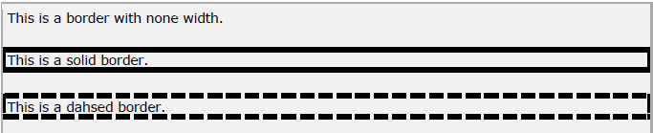
border-style
<p style=“border-style: none”>
This is a border with none width.</p>
<p style=“border-style: solid”>
This is a solid border.</p>
<p style=“border-style: dashed”>
This is a dashed border.</p>
Output:
Possible values:
none, solid, dashed, double, groove, ridge, inset, outset

Slide 33
border-color
<style>
p.example1 {
border-style: solid;
border-color: #FF0000;
}
</style>
<p class=“example1”>
This example is showing all borders in same color.
</p>
Output:
Possible values:
any color with valid format

Slide 34
Border Width
Can individually change the width of the bottom, top, left and right borders of an element.
  border-bottom-width : changes the width of bottom border.
  border-top-width :changes the width of top border.
  border-left-width :changes the width of left border.
  border-right-width : changes the width of right border.
<p style=“border-width: 4px; border-style: solid;”>
This is a solid border whose width is 4px.</p>
Possible values:
length in px, pt or cm or it should be thin, medium or thick.

Slide 35
POSITIONING

Slide 36
Positioning
Introduction
Relative positioning
Absolute positioning
Fixed positioning
Floating elements
Static positioning

Slide 37
CSS Positioning
Relies on CSS properties rather than tables to design a Web page.
  A growing trend is to configure pages using CSS
The technology for this is called “table-less layout”
CSS-P for CSS Positioning
“table-less” layouts may include tables to present info in a tabular manner to facilitate design of a small portion of the page.

Slide 38
CSS Positioning
Normal flow causes the browser to render the elements in the order they appear in the HTML/XHTML source code.
Using CSS for page layout the location of elements can be changed.
Cross browser-support positioning is more reliable when the <div> element is used for positioning.

Slide 39
Absolute positioning
Element is taken out of the normal flow of the page layout.
Position is specified using the left, right, top and bottom attributes.
To position in relation to the nearest ancestor
  If No positioned ancestors, it uses the document body
  Elements moves along with page scrolling.

Slide 40
Absolute Positioning
  Position an Element 20px from the top of the browser viewport, and 20px from the left
  <div style="position:absolute; left: 20px; top: 20px;"> </div>
To make the child element positioned absolutely from its parent element
  Parent Element is Positioned relative or Absolute
  Parent Element should NOT be static

Slide 41
Absolute Positioning
  .container{
    width: 400px;
    height: 300px;
    border: 1px solid #e52325;
    background-color: #ddbdff;
    position: relative;
    margin: 0 auto;
  }
  .content{
    width: 100px;
    height: 100px;
    border: 1px solid #ff748c;
    background-color: #fbdb65;
    position: absolute;
  }

Slide 42
Absolute Positioning
  <div class="container">
    <div class="content" style="left:10px;top:10px;" id="topleft">
    </div>
    <div class="content" style="left:10px;top:190px;" id="bottleft">
    </div>
    <div class="content" style="left: 290px;top:100px;" id="rightmiddle">
    </div>
  </div>

Slide 43
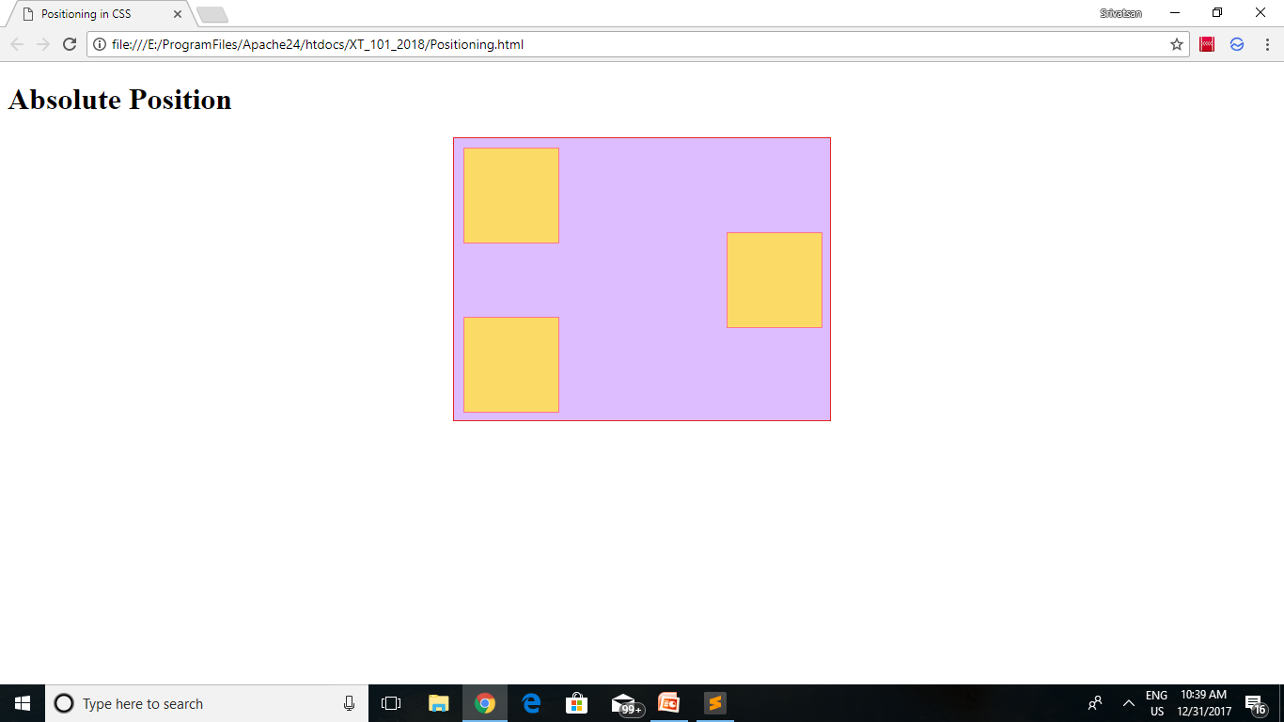
Absolute Positioning

Slide 44
Relative Positioning
  Use to slightly change the location of an element in relation to where it would otherwise appear in normal flow
  Setting the top, right, bottom, and left properties of a relatively-positioned element will cause it to be adjusted away from its normal position.
  Other content will not be adjusted to fit into any gap left by the element.
Limits the scope of absolutely positioned child elements.
  Any element that is a child of the relatively positioned element can be absolutely positioned within that block.

Slide 45
Relative Positioning
  .container{
    width: 400px;
    height: 300px;
    border: 1px solid #e52325;
    background-color: #ddbdff;
    position: relative;
    margin: 0 auto;
  }
  .content{
    width: 100px;
    height: 100px;
    border: 1px solid #ff748c;
    background-color: #fbdb65;
    position: relative;
  }

Slide 46
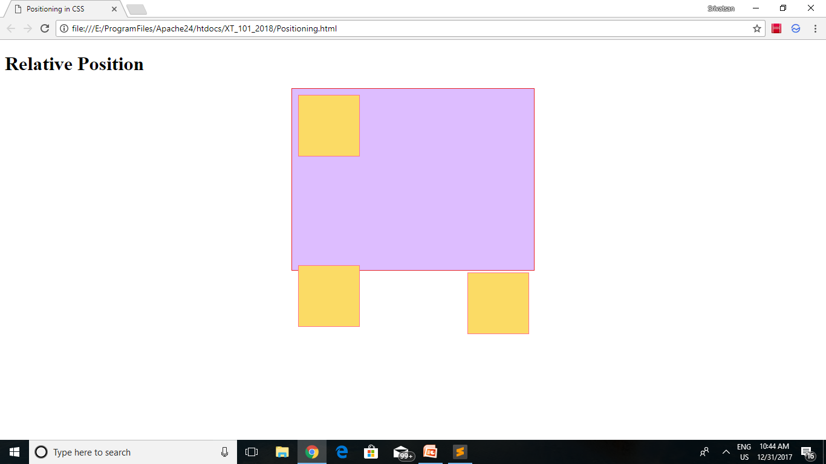
Relative Positioning

Slide 47
Fixed Positioning
Restricts an element to a specific position in the viewport, which stays in place during scroll:
  They are not considered to be bound by the viewport:
Absolutely-positioned elements are still bound by the viewport and will cause scrolling:
A fixed element does not leave a gap in the page where it would normally have been located.

Slide 48
Fixed Positioning
  .container{
    width: 400px;
    height: 300px;
    border: 1px solid #e52325;
    background-color: #ddbdff;
    position: relative;
    margin: 0 auto;
  }
  .content{
    width: 100px;
    height: 100px;
    border: 1px solid #ff748c;
    background-color: #fbdb65;
    position: absolute;
  }

Slide 49
Absolute Positioning
  <div class="container">
    <div class="content" style="left:10px;top:10px; position: fixed; " id="topleft">
    </div>
    <div class="content" style="left:10px;top:190px;" id="bottleft">
    </div>
    <div class="content" style="left: 290px;top:100px;" id="rightmiddle">
    </div>
  </div>

Slide 50
Static Positioning
A static element is said to be not positioned and an element with its position set to anything else is said to be positioned.
Elements are positioned static by default.
  They are not affected by the top, bottom, left, and right properties.
  Uses the normal flow of the page:
Relative positioning makes children absolute positioned be positioned relative to them,
Static allows absolutely positioned children to ignore their position and be positioned relative to the nearest relative positioned element.

Slide 51
Static and Relative Positioning
.container{
width: 400px;
height: 300px;
border: 1px solid #e52325;
background-color: #ddbdff;
position: static;
margin: 0 auto;
}
.content{
width: 100px;
height: 100px;
border: 1px solid #ff748c;
background-color: #fbdb65;
position: absolute;
}

Slide 52
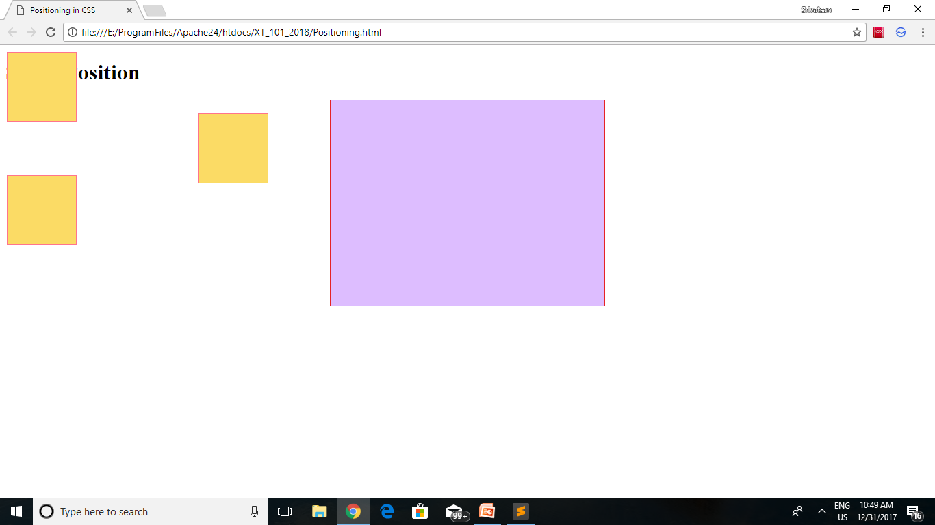
Static Positioning

Slide 53
Positioning
<div id="outer" style="position:relative">
<div id="inner" style="position:absolute; left: 20px; top: 20px;">
</div>
</div>
inner div would be positioned 20px from the top of the outer div, and 20px from the left edge of same, because the outer div isn't positioned with position:static
because the outer div isn't positioned with position:static because we've explicitly set it to use position:relative.

Slide 54
Floating elements
A very powerful positioning technique .
  By default, block level element takes up document’s 100% width
It takes element out of normal order and let other elements float around it.
Elements “float" on the right or left side of either the browser window or another element
Elements should have an intrinsic width configured
    Images are often configured using the float property.
float: left, right, none;

Slide 55
Floating
  .container{
    width: 75%;
    border: 1px solid blue;
  }
  img.styleImage{
    width: 50px;
    height: 50px;
    margin: 0px 10px 0 10px;
    float: left;
  }

Slide 56
Clear Floating
To stop flow clear property
  “clear” or terminate a float
Clear values: left, right, and both
. .rightfloat {
float:right;
  margin: 5px;
  clear:right;
  border: solid;
  }

Slide 57
Alignment vs. float vs. position
If possible, lay out an element by aligning its content
  horizontal alignment: text-align
    set this on a block element; it aligns the content within it (not the block element itself)
  vertical alignment: vertical-align
    set this on an inline element, and it aligns it vertically within its containing element
If alignment won't work, try floating the element
If floating won't work, try positioning the element
  absolute/fixed positioning are a last resort and should not be overused
In general, do not use float when you mean align,
The alignment defines the direction of the flow within an element, while a float takes an element out of the current flow.
Notes:
Find a good example or w3c

Slide 58
COLORS & BACKGROUNDS

Slide 59
Topics
Introduction
Text & Background colors
How colors work
Background images
The background-repeat property
The background-position property

Slide 60
color
Can apply any of the colors to a webpage by using the relevant CSS code.
background-color
  To set a background color,
color
  To set a background color,
border-color.
  To set a border color
Values can be specified by the popular three methods:
  Hexadecimal colors
  RGB colors
  Predefined/Cross-browser color names

Slide 61
Hexadecimal Colors
Supported in all major browsers.
#RRGGBB, where the RR (red), GG (green) and BB (blue)
Hexadecimal integers specify the components of the color.
All values must be between 00 and FF.
#0000ff : rendered as blue
  component is set to its highest value (ff) and the others are set to 00
Hex color has a choice of 16,777,216 colors.
HTML and CSS color choices are limited to 140 colors.
17 colors are from the HTML specification,
  123 colors are from the CSS specification.“
  Total of 140 color names are defined in the HTML5 and CSS3 color specifications.
  .

Slide 62
RGB Colors
Supported in all major browsers.
Specified with: rgb(red, green, blue).
Each parameter (red, green, and blue) defines the intensity of the color
  integer between 0 and 255 or a percentage value (from 0% to 100%).
rgb(0,0,255) rendered as blue
  blue parameter is set to its highest value (255) and the others are set to 0.

Slide 63
Opacity
The opacity property sets the opacity level for an element.
The opacity-level describes the transparency-level
1 is not transparent at all,
0.5 is 50% see-through,
0 is completely transparent.
div {
opacity: 0.5;
}

Slide 64
SELECTORS

Slide 65
CSS Selectors
Selectors are at the heart of CSS.
CSS allowed the matching of elements by type, class, and/or id.
CSS2.1 added pseudo-elements, pseudo-classes, and combinators.
With CSS3, we can target almost any element on the page with a wide range of selectors.

Slide 66
Universal Selector
* {
margin: 0;
padding: 0;
}
The star symbol will target every single element on the page.
Used to zero out the margins and padding.
It adds too much weight on the browser

Slide 67
Select by Id
#container {
width: 960px;
margin: auto;
}
Prefixing the hash symbol to a selector allows us to target by id.
Most common usage
id selectors are rigid and don't allow for reuse.
Can use a pseudo-class.

Slide 68
Class Selector
.error {
color: red;
}
This is a class selector.
The difference between ids and classes is that, with the latter, you can target multiple elements.
Use classes when you want your styling to apply to a group of elements.

Slide 69
Selector Grouping
Can be grouped using a comma (,) separator.
Any element that matches either of the selectors in the group:
td, th { ⋮ declarations }
  Similar to the logical OR operator,
  but it’s important to remember that each selector in a group is autonomous.
#foo td, th { ⋮ declarations }
#foo td { ⋮ declarations } th { ⋮ declarations }

Slide 70
Attribute Selector
a[title] {
color: green;
}
Select the anchor tags that have a title attribute.
a[href=“Welcome.html”] {
color: green;
}
* appear somewhere in the attribute's value.
^ for Beginning of the String
$ is used for end of the String

Slide 71
Attribute selectors
Attribute selectors selects elements based upon the attributes present in the HTML Tags and their value.
  IMG[src="small.gif"] {
  border: 1px solid #000;
  }
  will work for
  <img src=“small.gif” />

Slide 72
Descendent Selector
Ul a {
text-decoration: none;
}
The next most comment selector is the descendant selector.
Also known as Compound selectors
When you need to be more specific with your selectors, you use these.
Example : To target the anchors which are within an unordered list

Slide 73
Adjacent Selector
ul + p {
color: red;
}
This is referred to as an adjacent selector.
It will select only the element that is immediately preceded by the former element.
In this case, only the first paragraph after each ul will have red text.

Slide 74
Child selectors
A child selector is used to select an element that is a direct child of another element (parent). Child selectors will not select all descendants, only direct children.
HTML CSS
<div > DIV.abc > P {
<div class=“abc”> font-weight:bold;
<P> }
Hello there! </p>
</div>
</div>

Slide 75
General sibling selector
Selector is a tilde character (~).
Matches elements that are siblings of a given element.
To match a p element if it’s a sibling of an h2 element:
h2~p { ⋮ declarations }
<h2>Heading</h2>
<p>The selector above matches this paragraph.</p>
<p>The selector above matches this paragraph.</p>
Here, both paragraphs match the sibling selector h2~p

Slide 76
CSS-Pseudo classes
Pseudo classes are used to include special effects to some selectors.
Syntax : selector:pseudo-class {property:value}
For example: a:link {color:#00FF00}
CSS classes can be used with pseudo-classes.
Syntax: selector.class:pseudo-class {property:value}
For example: a.red:visited {color:#FF0000}
<a class="red" href=“c:\css_syntax.html">CSS Syntax</a>

Slide 77
CSS-Pseudo classes
Some of the pseudo classes are
  :active Adds a style to an activated element
  :first-child Adds a style to the first element that is the included in another element
  :focus Adds a style to an element that has keyboard input focus
  :hover Adds a style to an element when mouse moves over it
  :lang Adds a style to an element with the specific lang attribute
  :link Adds a style to an unvisited link
  :visited Adds a style to a visited link

Slide 78
Pseudo Class
input[type=radio]:checked {
border: 1px solid black;
}
A user interface element that has been checked
div:hover {
background: #e3e3e3;
}
a:link { color : red }
a:visited { color : green }
a:hover { color: yellow }

Slide 79
CSS3 Psuedo Classes
:last-child
matches an element that’s the last child element of its parent element
:first-of-type
matches the first child element of the specified element type
:last-of-type
matches the last child element of the specified element type
:only-of-type
matches an element that’s the only child element of its type
:root
matches the element that’s the root element of the document
:enabled
matches user interface elements that are enabled
:disabled
matches user interface elements that are disabled

Slide 80
CSS3 Psuedo Classes
:nth-child(N)
matches elements on the basis of their positions within a parent element’s list of child elements
:nth-last-child(N)
matches elements on the basis of their positions within a parent element’s list of child elements
:nth-of-type(N)
matches elements on the basis of their positions within a parent element’s list of child elements of the same type
:nth-last-of-type(N)
matches elements on the basis of their positions within a parent element’s list of child elements of the same type

Slide 81
pseudo Element
CSS classes can also be used with pseudo-elements:
selector.class::pseudo-element {
property:value;
}
:first-letter
represents the first character of the first line of text within an element
:first-line
represents the first formatted line of text
:before
specifies content to be inserted before another element
:after
specifies content to be inserted after another element
::selection
represents a part of the document that’s been highlighted by the user

Slide 82
pseudo Element
P::first-line {
font-weight: bold;
font-size: 1.2em;
}
We can use pseudo elements (designated by ::) to style fragments
Used to target first line, or the first letter.
Applied to block level elements in order to take effect.
P::first-letter {
float: left;
font-size: 2em;
padding-right: 2px;
}

Slide 83
Pseudo-elements
p { text-indent: 1em }
p.initial { text-indent: 0 }
p.initial:first-line { text-transform: uppercase }
p.initial:first-letter { font-size: 24pt }
This indents all normal paragraphs.
A paragraph that is declared with class="initial" is not indented, and its first line appears in all capital letters, with an extra-large first letter.

Slide 84
https://learn.shayhowe.com/html-css/positioning-content/
https://robots.thoughtbot.com/positioning

Slide 85
line-height
The line-height property can accept the keyword values normal or none as well as a number, length, or percentage.
According to the spec, a value of "normal" is not just a single concrete value that is applied to all elements, but rather computes to a "reasonable" value depending on the font size set (or inherited) on the element.
A length value can be defined using any valid CSS unit (px, em, rem, etc).
A percentage value is the font size of the element multiplied by the percentage. For example:
The line-height CSS property sets the amount of space used for lines, such as in text. On block-level elements, it specifies the minimum height of line boxes within the element. On non-replaced inline elements, it specifies the height that is used to calculate line box height.

Slide 86
body {
line-height: 1;
font-size: 20px;
}
p {
margin: 20px auto;
max-width: 600px;
}
.p1 {
line-height: 150%;
}
.p2 {
line-height: 200%;
}
.p3 {
line-height: 250%;
}

Slide 87
Text-align
The text-align CSS property describes how inline content like text is aligned in its parent block element. text-align does not control the alignment of block elements, only their inline content.
start | end | left | right | center | justify |
The standard-compatible way to center a block itself without centering its inline content is setting the left and right margin to auto, e.g.:
.something { margin: auto; }.something { margin: 0 auto; }

Slide 88
This is also the way to center an image: make it into block of its own and apply the margin properties to it. For example:
IMG.displayed { display: block; margin-left: auto; margin-right: auto } ... <IMG class="displayed" src="..." alt="...">

Slide 89
The example below centers a paragraph inside a block that has a certain given height. A separate example shows a paragraph that is centered vertically in the browser window, because it is inside a block that is absolutely positioned and as tall as the window.
DIV.container { min-height: 10em; display: table-cell; vertical-align: middle } ... <DIV class="container"> <P>This small paragraph... </DIV>

Slide 90
Using CSS to change vertical alignment
The vertical-align CSS property specifies the vertical alignment of an inline or table-cell box.
You can change the vertical position of images in relation to the surrounding text using the CSS vertical-align property.
The various properties that can be used include: top, text-top, middle, baseline, text-bottom, bottom, sub, super, percentage and length.
Top
The top of the image will align with the top line.
img.class-name { vertical-align: top; }

Slide 91
The vertical-align property can be used in two contexts:
To vertically align an inline element's box inside its containing line box. For example, it could be used to vertically position an <img> in a line of text:
To vertically align the content of a cell in a table:

Slide 92
<div>An <img src="https://mdn.mozillademos.org/files/12245/frame_image.svg" alt="link" width="32" height="32" /> image with a default alignment.</div> <div>An <img class="top" src="https://mdn.mozillademos.org/files/12245/frame_image.svg" alt="link" width="32" height="32" /> image with a text-top alignment.</div> <div>An <img class="bottom" src="https://mdn.mozillademos.org/files/12245/frame_image.svg" alt="link" width="32" height="32" /> image with a text-bottom alignment.</div> <div>An <img class="middle" src="https://mdn.mozillademos.org/files/12245/frame_image.svg" alt="link" width="32" height="32" /> image with a middle alignment.</div>CSS
img.top { vertical-align: text-top; } img.bottom { vertical-align: text-bottom; } img.middle { vertical-align: middle; }

Slide 93
TEXT AND FONTS

Slide 94
Text & Fonts
Introduction
Font-family - the basics
Font weight
Font style
Font size
Advanced typography
Text shadow
Text Decoration
Text Indent
Text Alignment

Slide 95
Image Borders
Rounded Corners
Box Shadow
overflow, resize
z-index
Transition
Transform

